Slide 1

Different Frontend Architecture
By Vasanth Bhat

Slide 2
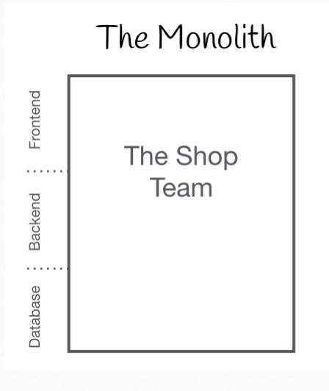
Monolith
Definition:
“A monolithic architecture is a traditional model of a
software program, which is built as a unified unit
that is self-contained and independent from other
applications.”

Slide 3
Monolith Pros and cons
Advantages
Easier continuous development
Reduced latency
Disadvantages
Difficulty in scaling
Simple in the beginning and difficulty while scaling

Slide 4
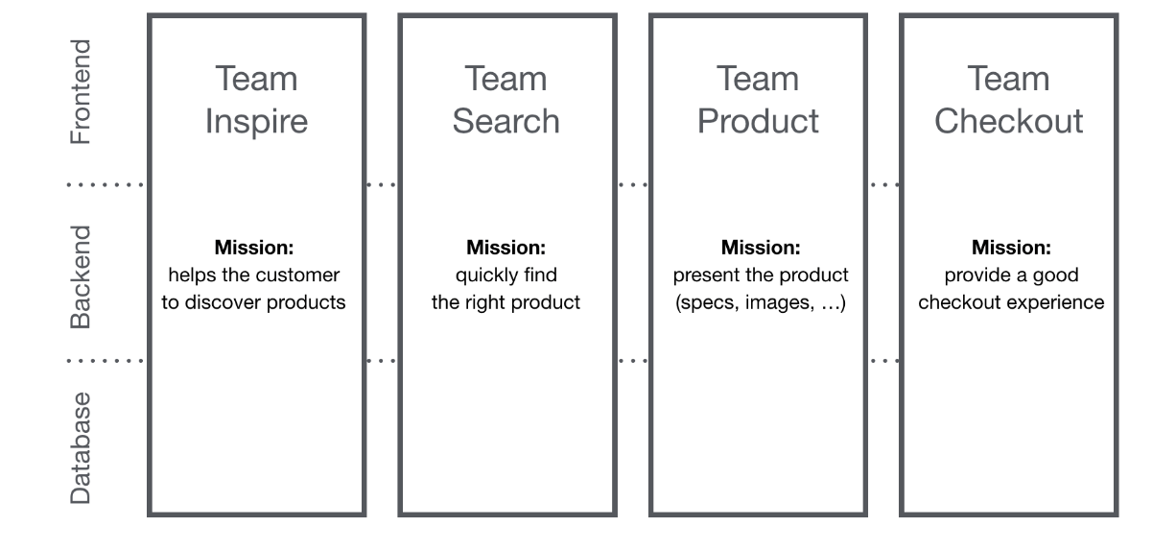
Micro frontend
“The idea behind Micro Frontends is to think about a website or web app as a composition of features which are owned by independent teams. Each team has a distinct area of business or mission it cares about and specialises in. ”
Src: micro-frontends.org/

Slide 5
Micro frontend Example
IKEA
Starbucks
DAZN

Slide 6
Micro frontend Pros and cons
Advantages
Adopting different tech stack
Development and deployment become faster
Easy maintainability
Disadvantages
Code duplication.
Extra effort in review and migration.

Slide 7
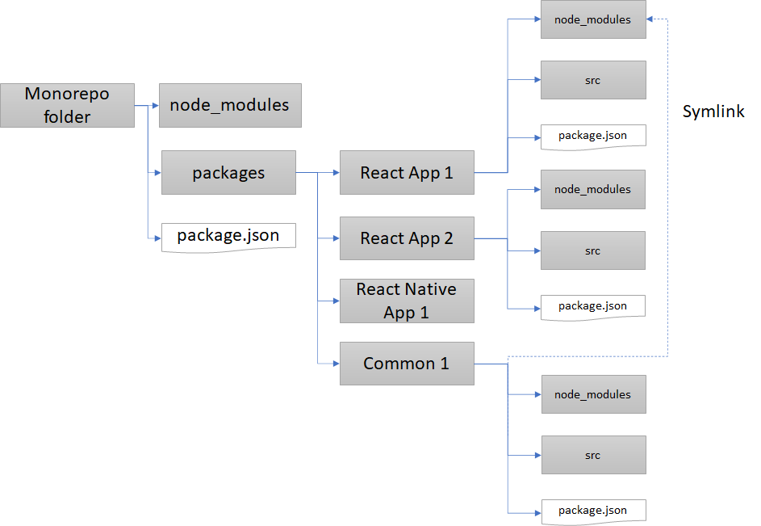
Monorepo
“A code management and architectural concept whereby you keep all your isolated bits of code in one super repository instead of managing multiple smaller repositories ”
Ex: Google, Facebook, Microsoft,
Uber, Airbnb, and Twitter

Slide 8
Difference between Monolithic vs Monorepo
Monolithic
Monorepo
Entire source code of the project lies in one repository.
Entire application is deployed in one go.
Each meaningful unit can have a separate repository.
Individual projects can be deployed separately.

Slide 9
Monorepo libraries
Pnpm/Yarn Workspaces
NX
Rush (By microsoft)
Lerna
Bazel Build (By Google)

Slide 10
Monorepo Props and cons
Pros
Cons
Code/library reuse.
Faster review.
Updating major dependencies/lint rules is super easy.
No way to restrict access only to some parts of the app.
Too many packages lead to longer bootstrap times.
Poor Git performance when working on large-scale projects.
The code navigation is slightly slower. Developers are now opening individual packages to work around that.

